Slide 1
Green Cloud Computing
Cloud
PRESENTED BY
GOVARDAN.N.A.
II YEAR-BE COMPUTER SCIENCE AND ENGINEERING
M.I.E.T ENGINEERING COLLEGE
TRICHY-7
Computing

Slide 2
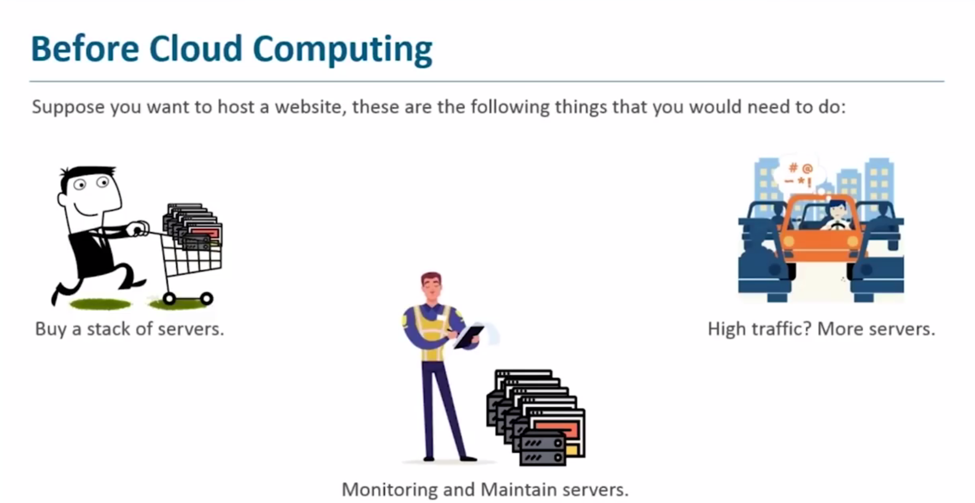
Why Cloud Computing ?

Slide 3
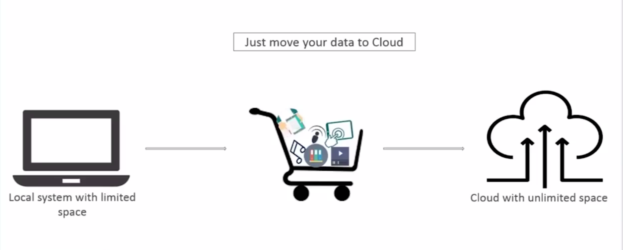
What is Cloud Computing
Cloud Computing is:
Storing / accessing data on remote servers.
Processing data / applications from servers.
Accessing data / applications via internet.

Slide 4
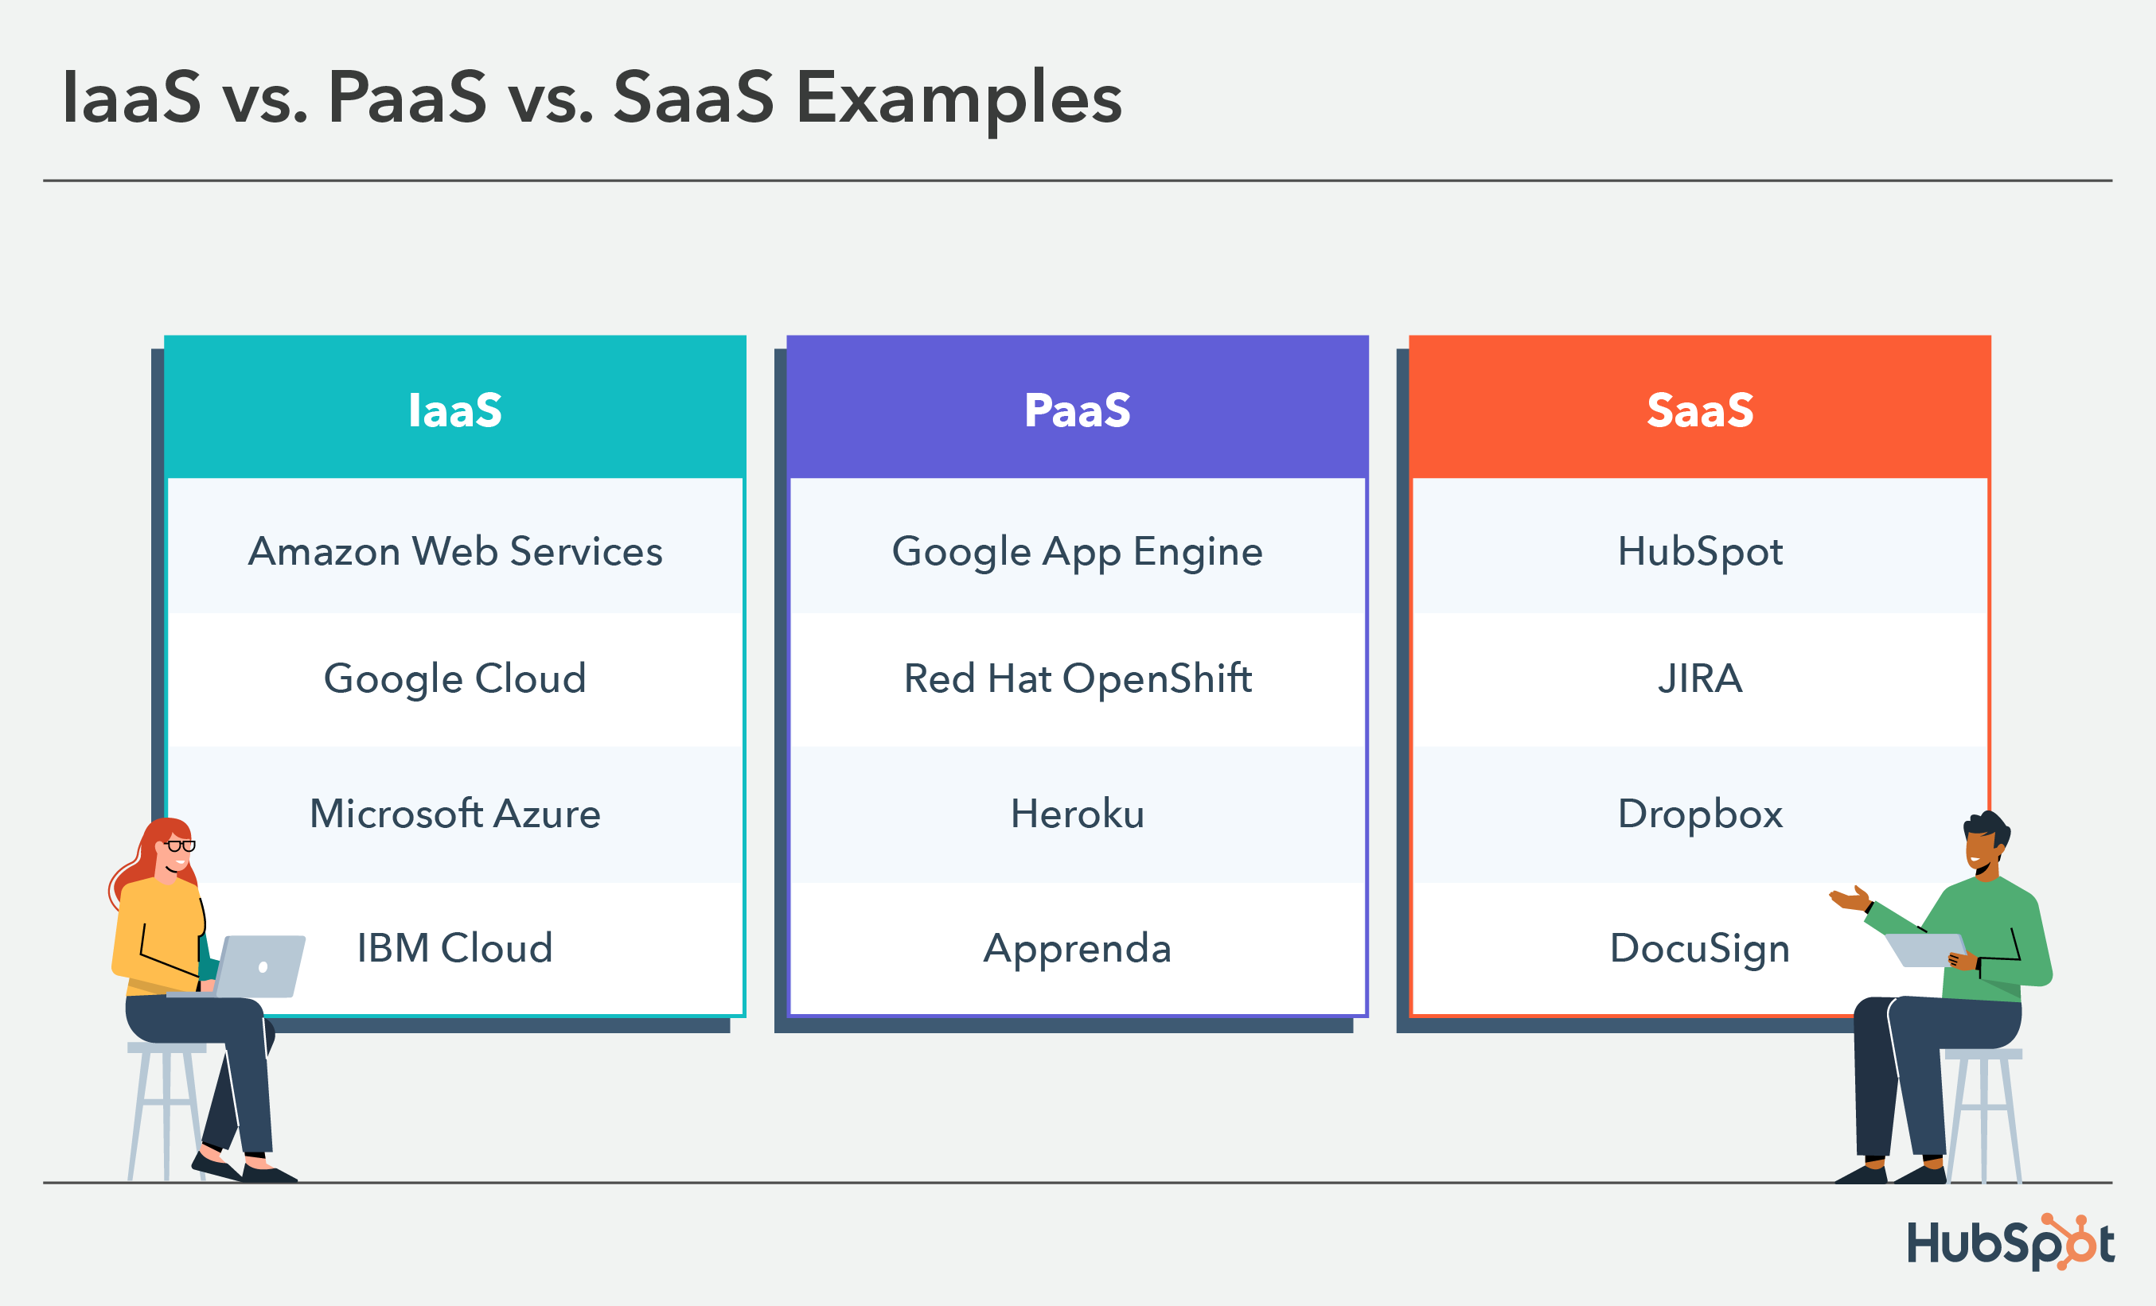
Cloud Service Models
Three most popular type of Cloud Computing services
Software-as-a-Service (SaaS): You access ready-to-use cloud-based applications via the internet without installing or maintaining them.
Platform-as-a-Service (PaaS): You rent servers, storage and networking resources from a cloud provider and pay as you go.
Infrastructure-as-a-Service (IaaS): You use a cloud provider’s platform to develop, run and manage applications without worrying about the underlying infrastructure.
Examples

Slide 5
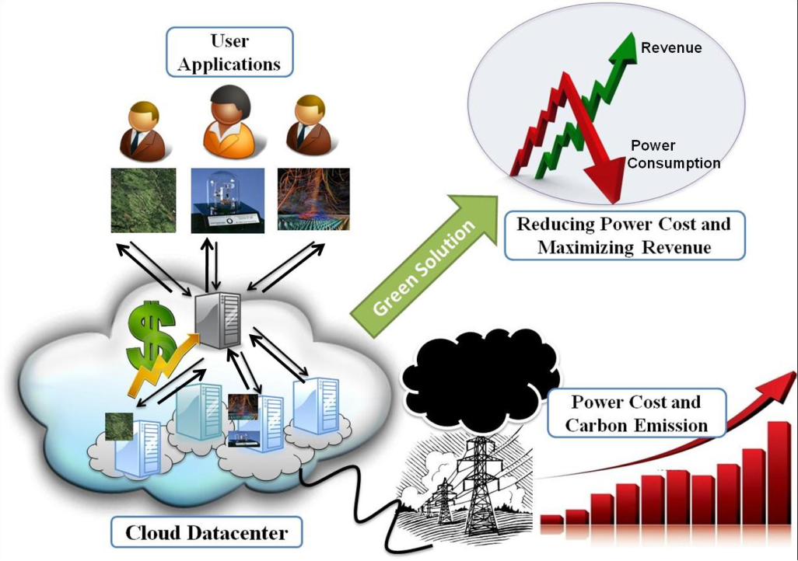
Green Cloud Computing
Why Green Cloud Computing ?
250$ is spend per year for powering computers world wide, 15% goes wasted in this.
Reduce Global Warming.
Reduce Pollution.
Not only these solutions, it also reduce operational costs.

Slide 6

Carbon Footprint of Green Cloud Computing
Carbon Footprint in Green Cloud Computing is the amount of green house gas emissions that are caused by use of Cloud Computing services and infrastructure.
Green Cloud Computing is a practice of designing and operating cloud systems in a way that minimizes their environment impact and reduces energy consumption.
Some of the benefits of green cloud computing are lower carbon emissions, lower operational costs, improved performance and reliability.

Slide 7
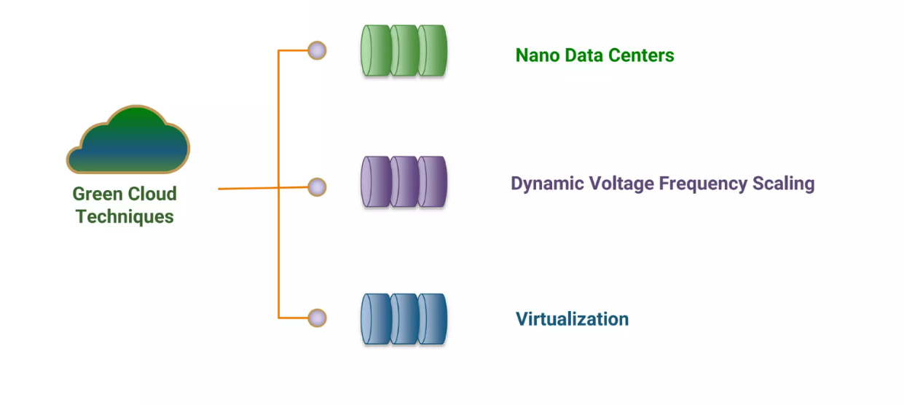
Green Cloud Techniques

Slide 8
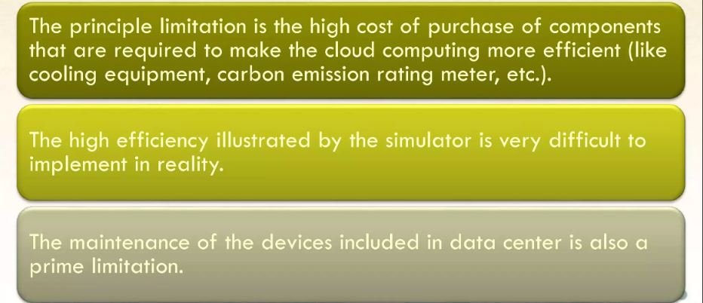
Limitations of Green Cloud Computing

Slide 9

Conclusion
Green Cloud Computing is changing the technological world. It is not only a new trend but a technology that allows change to become more environment friendly that too with low-cost IT budget.

Slide 10

Reference
Robert Sheldon
https://www.techtarget.com/searchstorage/definition/green-cloud
SRM VEC CSI’AN
https://youtu.be/57GcUoOgD8s
Edureka
https://youtu.be/k1RI5locZE4
Wiley Press, New York, USA.

